Slide 1
Data Lab: Paper Mill Challenge from INFORMS
ISyE, Georgia Institute of Technology

Slide 2
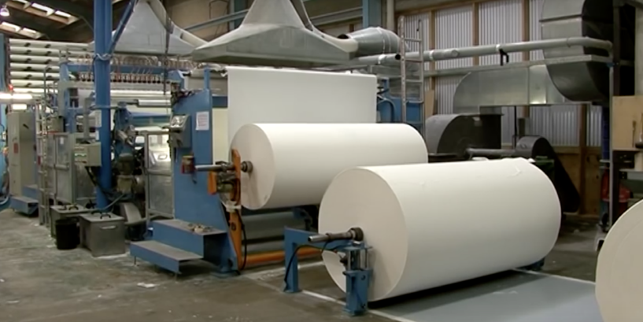
Illustration of a Working Machine
Ranjan et al., “Dataset: Rare Event Classication in
Multivariate Time Series”

Slide 3
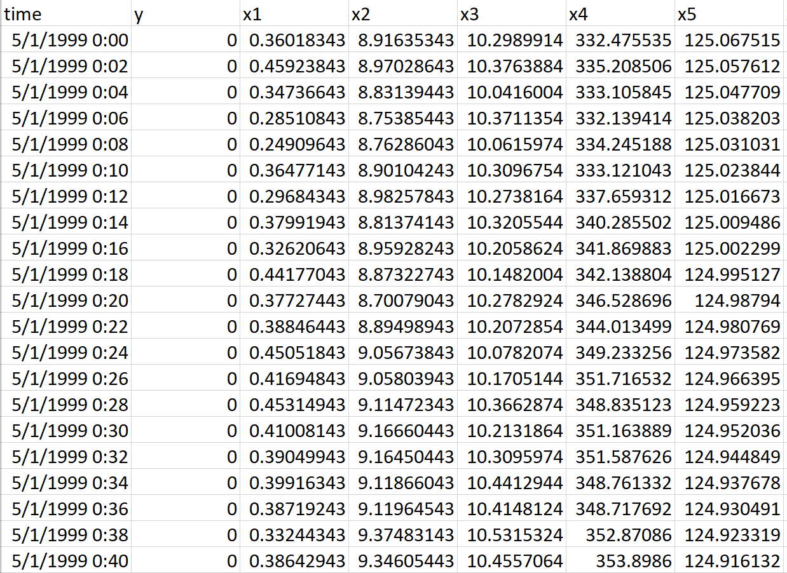
A Snapshot of Raw Data
Real-world dataset from a paper mill
Variables on raw materials (e.g. amount of pulp fiber) and process variables (e.g. motor speed)
2-minute interval
Want to predict the breakdown some time before it does

Slide 4
Data Statistics
19,461 records
Columns
Time Stamps
Y-label: Indicator (0,1 encoded) of machine breakdown
Predictor variables: 61 types, continuous except for two (x28, x61)
Y-label is highly imbalanced (machine breaks down seldomly)
Given records up to time t, can we predict y-label at t+1 or even t+2?
For this session, we only try to predict 1 time-unit (2 mins) ahead

Slide 5
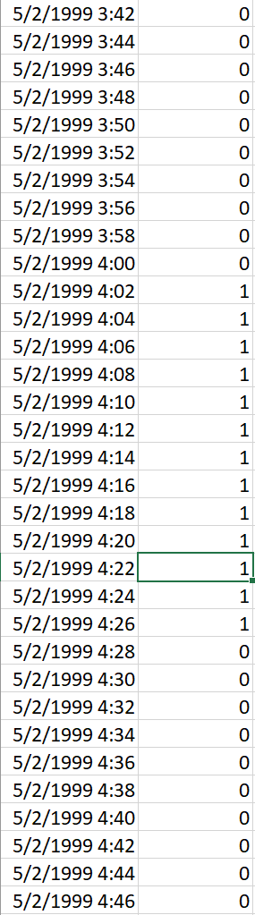
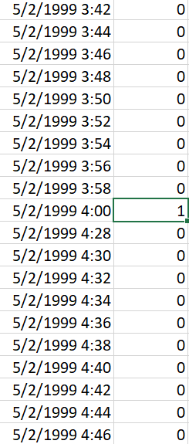
Data Preprocessing
Y-labels shifted by 1 time-unit
Consecutive 1’s removed
End up with 16,446 training samples (in “train.csv”) and 1827 test samples (in “test.csv”).
Raw Data
Preprocessed Data

Slide 6
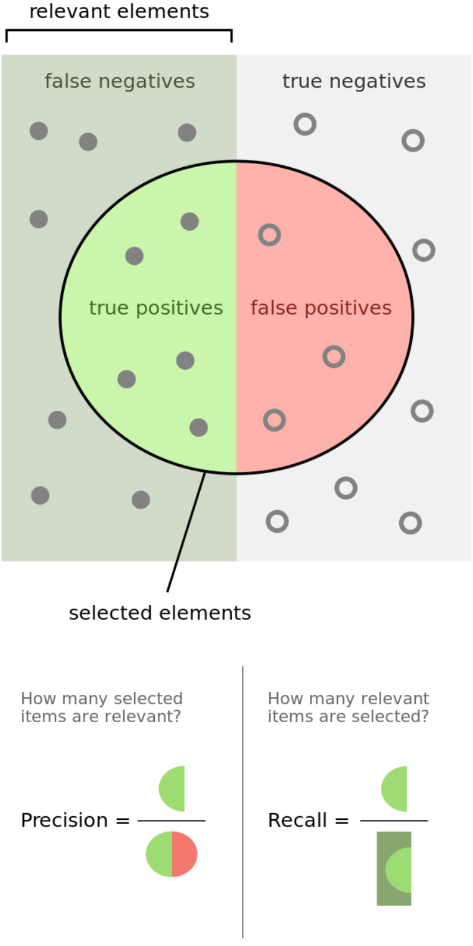
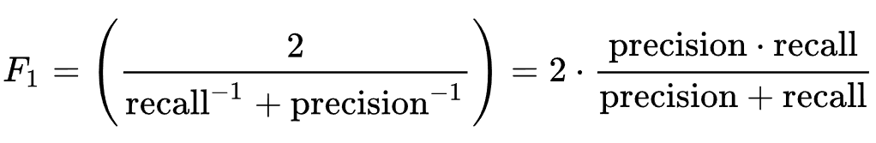
Evaluation Metric
F-1 score: Harmonic mean of recall and precision
https://en.wikipedia.org/wiki/F1_score

Slide 7
Basic Suggested Approaches
Logistic Regression
Gradient Boosting
Recurrent Neural Network
Benchmark F1-score: 0.114

Slide 8
Practical Implementation
Resource Access from:
https://github.com/susain/Data_Lab_paper_mill
Anaconda:
https://www.anaconda.com/distribution/
Jupyter Notebook
F1-measure

Slide 9
Live Code Example

